Slide 1
ValShop
A Price Comparison Web Application

Slide 2
Contents
Concept
Description
User Story
Acceptance Criteria
Process
Technologies Used
Roles / Tasks
Challenges / Successes
Demonstration
Future Development

Slide 3
Concept
Description
A web application that will allow a user to quickly and effectively compare a products price and availability across multiple ecommerce platforms.
User Story
AS A price conscious consumer, I WANT to be able to price check items that I am interested in purchasing across multiple outlets, SO THAT I can ensure I am getting the best price and value.

Slide 4
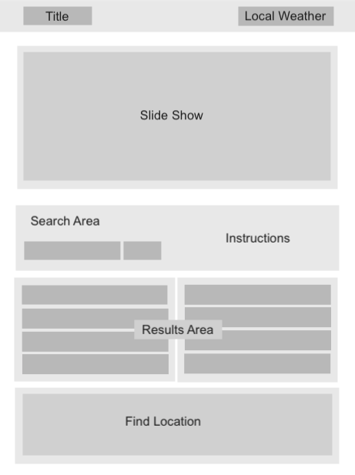
Concept (cont.)

Slide 5
Process
Technologies Used
API
Price Retrieve from Rapid API
Open Weather Map
Google Maps
CSS Framework
Foundation

Slide 6
Process (cont.)
Roles / Tasks
Front End
Venus
Hatem
Back End
Logique
Muhammad
Project Management / Floating
Tim

Slide 7
Process (cont.)
Challenges / Successes
Challenges
Proof of Concept
eCommerce API and data return
CSS Framework
Successes
Proof of Concept
eCommerce API and data return
CSS Framework

Slide 8
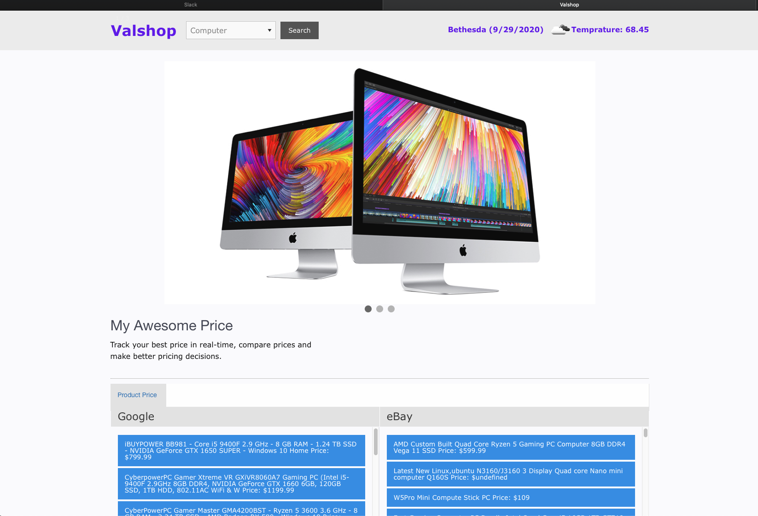
Demonstration
ValShop

Slide 9
Future Development
Additional Features
Specific product search
Availability query
Expanded retailers
Dynamic shopping method selection

Slide 10
Questions

